Slide 1
A Sequential GRASP for the Therapist Routing and Scheduling Problem
J. F. Bard, Y. Shao, A. I. Jarrah
Presented by Nihal Berktaş

Slide 2
Outline
Motivation
About GRASP
Problem Definition and Setting
MIP model and additions
Solution Methodology
Phase I
Phase II
Computations

Slide 3
Motivation
Workforce is majority of the costs
providing rehabilitative service to patients located at clinics, hospitals, nursing homes and other facilities
Physical therapy
Independent agent
Days available, time windows
Demand is known
Notes:
Focused on physical therapy but result is applicable to all services using house call model
Independent agent who work for regional rehab comp that have long term service contracts with healthcare facilites
At the beginning of each week therapist submits his available days, hours and perhasp preference ofr treatment locations

Slide 4
Motivation
Considerable work in scheduling but difficulty remains. Why?
Fixed and flexible patients
Feasible patterns
Multiple sessions
Therapist lunch breaks
Licensed therapist vs assistant therapist
These factors restricts feasible region
so far done manually
Notes:
30 years of considerable work in scheduling but the diff remains
5 points

Slide 5
About GRASP
Greedy Randomized Adaptive Search Procedures
A GRASP is a multi-start or iterative process (Lin and Kernighan, 1973)
each GRASP iteration consists of two phases,
a construction phase, in which a feasible solution is produced,
and a local search phase, in which a local optimum in the neighborhood of the constructed solution is sought.
The best overall solution is kept as the result.
Notes:
the
underlying philosophy ofGRASP is to construct a wide variety
of feasible solutions and then try to improve a subset
of them through simple neighborhood search.

Slide 6
About GRASP
In the construction phase, a feasible solution is iteratively constructed, one element at a time.
At each construction iteration, the choice of the next element to be added is determined by ordering all candidate elements (i.e. those that can be added to the solution) in a candidate list C with respect to a greedy function g : C !R.
The heuristic is adaptive because the benefits associated with every element are updated at each iteration of the construction phase to reflect the changes brought on by the selection of the previous element.
The probabilistic component of a GRASP is characterized by randomly choosing one of the best candidates in the list, but not necessarily the top candidate. The list of best candidates is called the restricted candidate list (RCL).
(Festa and Resende 2004)

Slide 7
In previous work Parallel GRASP
Now constructing tours sequentially
to balance feasibility with optimality when selecting the next route to explore
design of an adaptive rule which enables us to trade off solution quality with solution diversity when selecting the next patient to schedule
Notes:
For the TRSP in which feasibility and optimality
highly depend on the distances between patients, it is much
more efficient to create routes in sequence where patients
who are close together are only assigned to the same therapist
if time permits; we found that clustering patients at the
same location is often suboptimal.
The other major contributions of our algorithm center on
two novel features. The first is an innovative technique that
aims to balance feasibility with optimality when selecting the
next route to explore. The second is the design of an adaptive
rule which enables us to trade off solution quality with solution
diversity when selecting the next patient to schedule.

Slide 8
Literature
Healthcare work routing
Cheng and Rich (1998)
Bertels and Fahle (2006)
Bennett and Erera (2011)
Eveborn et al.(2006)
Patients Scheduling
Gupta and Denton (2008)
Green and Savin (2008)
Muthuraman and Lawley (2008)
Çayırlı et al. (2008)
Patrick et al. (2008) Markov
Notes:
Healthcare Mostly focused on nursing services
Green and Savin (2008) no show
Muthuraman and Lawley (2008) stoc 3 obj
Çayırlı et al. (2008)

Slide 9
Problem Definition
TRSP
For each k ∈ K, construct a weekly schedule that minimizes the total treatment, travel, overtime, administration and mileage costs of providing service to each i ∈ I
By specifying the weekly patterns for all flexible patients
and by ensuring that the time windows of all patients and therapists are respected,
that new patients are seen by a PT during their first treatment,
and that route continuity is maintained for all therapists each day of the planning horizon.

Slide 10
Indices and sets
i, j Index for patients; I Set of patients to be seen I = IFIX ∪ IFLEX
k Index for therapists ; K Set of all therapists; K = {PTs, PTAs}
d Index for days
o(k), d(k) Origin, destination of therapist k
K(i, d) Set of therapists that can see patient i on day d
IC(i, d, k) Set of patients that can follow patient i in a schedule for therapist k on day d
IK (k, d) Set of patients that can be seen by therapist k on day d
DK(k) Set of days therapist k can be scheduled to work
DU(i ) Set of days in the planning horizon that patient i is to be treated (pattern given)

Slide 11
Data and parameters
c^{k}_{ij} :Cost of traveling from patient i to patient j by therapist k
c^{k}_{id} :Cost of a visit by therapist k to see patient i on day d
s_{id} :Time required to provide treatment to patient i on day d
a_{id} , b_{id} :Earliest, latest time treatment can begin for patient i on day d
τ_{ij} :Travel time between patients i and j (assumed symmetric)
e_{kd} , f_{kd} :Earliest start, latest finish time of therapist k on day d
Decision variables
x^{k}_{ijd} 1 if therapist k visits patients i and j in succession on day d, 0 otherwise
t_{id} :Time at which patient i begins to receive treatment from a therapist on day d

Slide 12
The MIP Model

Slide 13
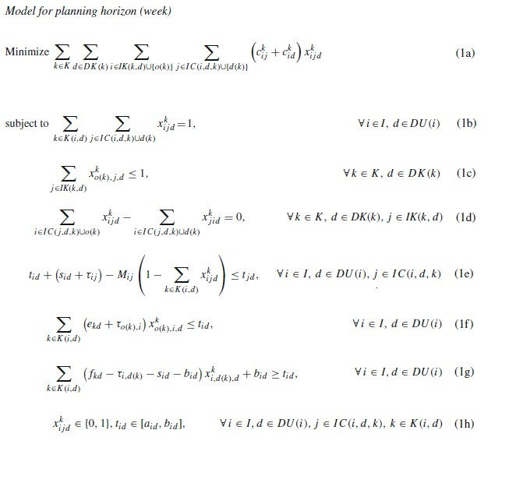

Slide 14
Additional requirements
Patient Patterns
+ binary variable for each pattern
First visit
Two cases : one of the visit and first visit
Multiple session per day
Multiple records of patients, break between sessions
Lunch breaks
Half hour between 11am -1 pm
binary variable i,j,k,d
continuous variable for starting time k,d
Tracking paid time and overtime
After 40 hours in a week
Notes:
So why not a day schedule at a time
Bcoz of overtime
Patterns for flexible patients
One PT visit for some patients
Multiple treatments in a day

Slide 15
Solution Methodology
Adaptive Sequential Grasp
Phase I randomly selecting therapist-day pairs in sequence and finding the optimal route for each turn (250 times)
Phase II improves a subset of candidates using a high level neighborhood search defined by insertions and swaps

Slide 16
Sequential vs Parallel
Sequential
One route at a time
Parallel
Multiple route simultaneously
If feasibility not an issue and optimality is in focus

Slide 17
Phase I
Step 1:Fixing (first) visit day when PT is required
Step 2: All compatible therapist-day tours are identified and one of them say (k*,d*) selected to built.
Step 3: Identify and sort a subset of patients who are eligible for route (k*,d*) and randomly select
When a route is no longer extended a new one is started.
Termination: When all patients are routed or no feasible threapist-patient pairs are left (very expensive super therapist)

Slide 18
Step 1:Fixing (first) visit day when PT is required
Ex 1: Assume patient i has feasible patterns
(1, 2, 3),(1, 2, 4), (2, 3, 4) and (3, 4, 5). Thus, the candidate set D1 ={1, 2, 3}, so the first visit would be randomly fixed at day 1,2 or 3 with probability 1/3.
Ex 2: or assign probabilities according to the frequencies
Frequency set (2,1,1)
so the probabilities of selecting days 1, 2 or 3 for the first visit are 2/4, 1/4, and 1/4, respectively.
More sophisticated rules can be used such as looking PT s time left for each day

Slide 19
Step 2: Route Selection
Step 2.1: Determining candidate list of days
Total amount of available therapist time for day d
available remaining time for therapists for each day (fixed patients, already assigned patients, flexible patients who must be seen on that day due to their patterns)
Level the days
Ex 3: days {1,2,3,4,5} total time {12,8,4,16,8}
Treatment, travel and adm. time so remaining {5,0,4,0,2}
first level day 1,3 second level day 5, third level day 2,4
so the candidate day list is D={1,3}

Slide 20
Step 2: Route Selection
Step 2.2: Selecting next route (k,d)
Having candidate day list, list all therapist-day pairs
R={(k,d): d in D and k in K(d)}
Sort increasing order of wage rates
Restricted candidate list
Take first m entries so selecting one has prob 1/m
Ex 4: D={1,3} therapists k1,k2,k3 with wage rates 40,50,35
k1 and k2 work on day1, k3 works on day 3
so candidate routes R={(k1,1)(k2,1)(k3,3)}, CL= {(k3,3)(k1,1)(k2,2)}
if m=2 then RCL= {(k3,3)(k1,1)} with prob of selecting one is 0.5

Slide 21
Step 3: Route Construction
So (k,d) pair is selected
Determine candidate patients I(k,d)
k is certified to treat patient i?
Feasible pattern of patient i includes d?
Assigning one patient at a time to the route (starting and ending o(k), d(k))
Step 3.1 Decide on the length of RCL for selecting next patient
Within a certain distance from therapist’s home
Not fixing it to be some value, instead giving an interval
Step 3.2 Construct RCL by calculating earliest time that next treatment can start
Step3.3 Benefit measure computed for each patient in RCL
Step 3.4 one of the top candidates are randomly selected

Slide 22
Step 3: Route Construction
Step 3.2 Construct RCL by calculating earliest time that next treatment can start
t_{i}: starting treatment time s_{id} : treatment time τ_{ij} : travel time
t^_{j} = t_{i} + S_{id} + τ_{ij}
T_{j}: {a_{jd} if j is Fixed, max(a_{jd},t^_{j}) if j is flex}
Ex5: Current patient’s treatment starts at 13.50 and treat. Time 0.5 hours
therapist works (8.00 -17.00)
Also if patient has multiple sessions more t_{j} s and checking lunch break

Slide 23
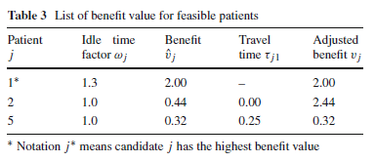
Step 3: Route Construction
Step 3.3 Benefit measure computed for each patient in RCL
Considering idle time, travel times, treatment times
Step 3.4 Selecting next patient j
So here the RCL is {2,1,5} If m=2 then then patients 1 and 2 will be selected with probability 0.45 and 0.55 respectively.

Slide 24
Phase 2
Not called after every Phase 1 iteration
Two procedures
Insertion: moving one patient from her current location to another one in the same route or in a different route
Swapping: exchanging two patients who are either in the same route or in different routes
Slack block: pieces of a sequence
Starts with a fixed patient or o(k)
Ends with a fixed patient or d(k)
Any patient in between is flexible
So the change of patient i only causes changes in the patients after i in his block

Slide 25
Phase 2
Route Feasibility after modification
Pattern feasibility
Therapist
Day in patients pattern
Ex 9: Assume patient i requires 3 treatment during week on each separate days. Current (1,2,3) if we want to move treatment on day 3 to day 2 it would be infeasible
Time feasibility
Calculate idle time in new sequence, if negative then infeasible
Also lunch break should be shifted like treatment times

Slide 26
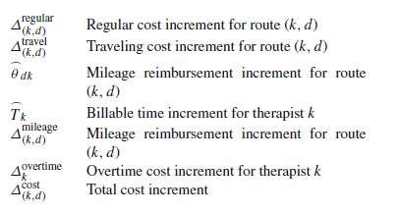
Phase 2
Cost efficiency of modification
Regular (treatment)
Administrative
Travel
Travelling millage reimbursement
Overtime cost
If the change in cost is higher than the treshold then the modification is efficient

Slide 27
Phase 2
Insertion
Swapping

Slide 28
Computations
Real data
5 datasets from Key Rehab
Single week operations in Eureka and Wichita
May, Nov, Dec. 2010 and March, April 2011
Table of patient and therapist characteristics

Slide 29
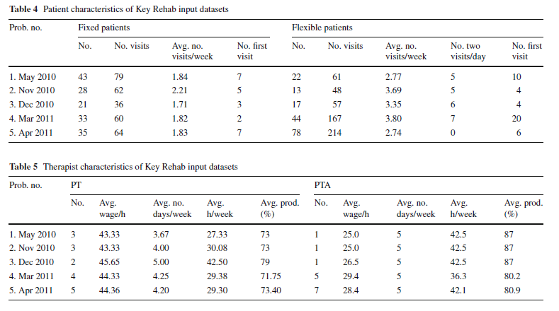
Computations

Slide 30
Computations
Implemented in C++ and run on a PC with 12GB of memory and an Intel i7 950 processor that has 4 3.06 Ghz cores
After many experiment parameters are set as follows
No of iteration 250
Frequency in phase II iteration is 5
No of candidate routes in RCL is 10
Parameters to determine length of RCL Imin=1, Istd=10 Imax=20
No of top candidate patients considered in RCL, 3
Benefit function α=1 β=2 ε=0.0001
Improvement threshold (for cost) 1
No time limit

Slide 31
Computations
To be able to compare the solution with real schedules
jhjh

Slide 32
Computations
Comparision
Eff = treatment cost / total cost

Slide 33
Computations
Sequencial vs Parallel vs LP

Slide 34
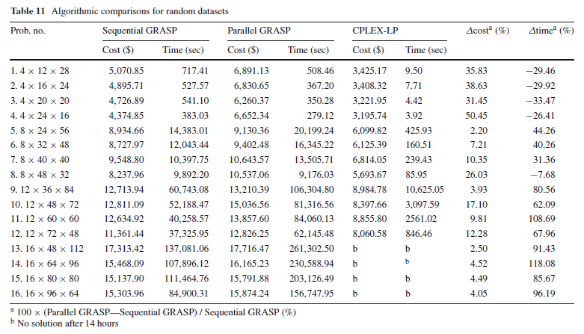
Computations
Random data to compare seq and parallel

Slide 35
Conclusion
Average cost reduction of 18% wrt current practise
5.58% improvement over parallel Grasp
Further
Decomposing therapists and patients by region
Specialized clustering algortihm
Column generation algorithm

Slide 36
Thank you for your attention!
Any questions or comments?

