Slide 1
Trading Software
User Guide
(c) 2015 Bilkent University Computer Center

Slide 2
https://stars.bilkent.edu.tr/trading-portal
or
http://ge402.bilkent.edu.tr
and click “Stock Market”

Slide 3
Login to your account

Slide 4
Buy shares

Slide 5
Sell shares

Slide 6
Your transaction history

Slide 7
Forgot your password?

Slide 8
Forgot your password?

Slide 9
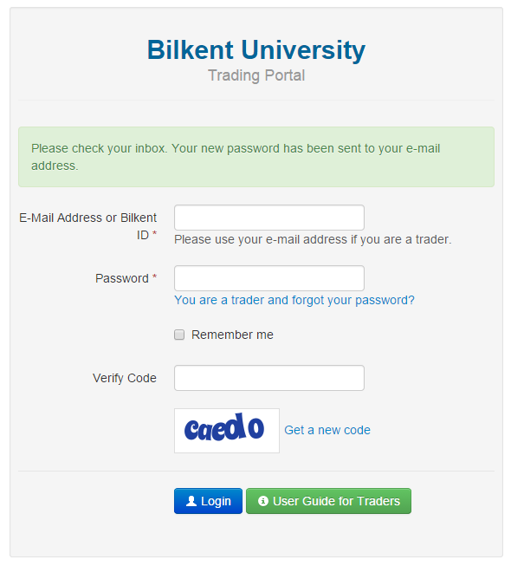
Forgot your password?

Slide 10
Forgot your password?

Slide 11
Public access to share prices and graphs
https://stars.bilkent.edu.tr/trading-portal/public/index

Slide 12
Company index

Slide 13
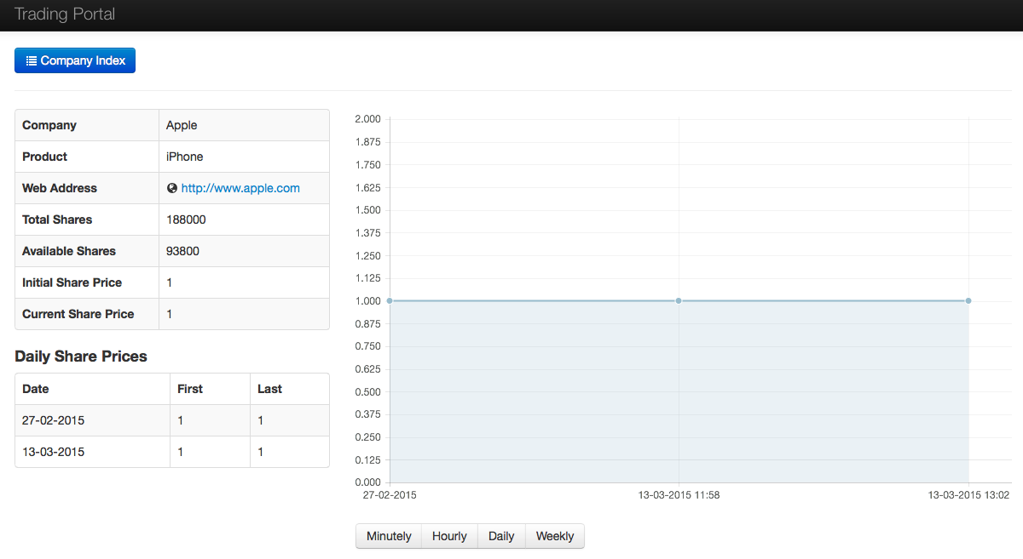
Company details

Slide 14
hdogan@bilkent.edu.tr
If you have encountered a technical issue

