Slide 1



2026-2027 ACADEMIC YEAR ERASMUS+ STUDENT MOBILITY FOR STUDIES PROGRAM
INFORMATION SESSION
OFFICE OF INTERNATIONAL STUDENTS
AND EXCHANGE PROGRAMS

Slide 2

Your attendance is mandatory for this Zoom/ Info Meeting. Otherwise “-5 points”reduction will be applied to the following Erasmus Programme application.

Slide 3

ERASMUS+ PROGRAM
What is Erasmus+ Program?
Erasmus+ Program, is a European Union program which encourages European higher education institutes to collaborate with each other.
What is Erasmus+ Student Mobility?
The Erasmus program allows you to study for one semester at a European higher education institution holding an Erasmus Charter for Higher Education (ECHE), without paying tuition fees.
In order to support the students financially, the European Commission distributes monthly grants.

Slide 4
ERASMUS+ PROGRAM
Who is the National Agency?
The European Commission ensures its communication with Turkish Universities whom hold an ECHE, through T.C. Ministry for EU Affairs, Center for European Union Education and Youth Programs (National Agency)
Contact Information:
www.ua.gov.tr
Mevlana Bulvarı No:18
Balgat-Ankara

Slide 5
Office of International Students and Exchange Programs (OISEP)
OISEP coordinates all exchange programs at Bilkent University.
Organizes orientation programs for both incoming and outgoing exchange students and helps them with all administrative issues they face during their stay.
Responsible from Bilkent University’s relations with the Turkish National Agency and international partnerships for Erasmus and Bilateral Exchange Programs.

Slide 6

Office of International Students and Exchange Programs (OISEP)
Erkin TARHAN – Director
Tel: +90 312 290 3108
Elif ÜNSAL – Student Advisor
Tel: +90 312 290 1129
Beyza MAKAM – Student Advisor
Tel: +90 312 290 31 57
Emre GÜNAL – Student Advisor
Tel: +90 312 290 30 73
e-mail: exchange-out@bilkent.edu.tr

Slide 7

Where is Office of International Students and Exchange Programs ?
Located in the Registrar’s Office Building
http://www.bilkent.edu.tr/bilkent/admission/outgoing_exchange/
Office and Call Hours:
Monday: No office or call hours
Tuesday: 09:00-11:00, 14:00-16:00
Wednesday: 09:00-11:00, 14:00-16:00
Thursday: 14:00-16:30
Friday: 14:00-16:30
For emergencies, please e-mail to:
exchange-out@bilkent.edu.tr

Slide 8
Academic Department Erasmus Coordinators for Course Approval
Faculty of Business Administration students can contact
Ms. Buket Bıyıklı
Phone:290 1928
E-mail: buket.biyikli@bilkent.edu.tr
Faculty of Economics, Administrative and Social Sciences students can contact
Ms. Betül Esmer
Phone: 290 2320
E-mail: betul.esmer@bilkent.edu.tr

Slide 9
Academic Department Erasmus Coordinators for Course Approval
Faculty of Engineering students can contact
Ms. Yelda İrem Ateş
Phone: 290 2351
E-mail: yeldaates@bilkent.edu.tr
Faculty of Art, Design and Architecture students can contact
Ms. Melek Koca Er
Phone: 290 1486
E-mail: meleker@bilkent.edu.tr

Slide 10
Academic Department Erasmus Coordinators for Course Approval
Faculty of Art, Design and Architecture | Architecture | Giorgio Gasco | giorgio.gasco@bilkent.edu.tr
 | Communication and Design | Melih Aydınat | melih.aydinat@bilkent.edu.tr
 | Fine Arts | Serdar Bilici | serdar.bilici@bilkent.edu.tr
 | Graphic Design | Çavlan Başarır | cavlan@bilkent.edu.tr
 | Interior Architecture and Environmental Design | Burcu Egel | aydinalp@bilkent.edu.tr
 | Landscape Architecture and Urban Design | Hatice Karaca | hkaraca@bilkent.edu.tr

Slide 11
Academic Department Erasmus Coordinators for Course Approval
Faculty of Humanities and Letters | English Language and Literature | Timothy Sean Wright | timothy.wright@bilkent.edu.tr
 | American Culture and Literature | Kyra Casher Sutton | kyra.sutton@bilkent.edu.tr
 | Archeology and History of Art | Benjamin Titus Irvine | benjamin.irvine@bilkent.edu.tr
 | Philosophy | Mary Katrina Krizan | mary.krizan@bilkent.edu.tr
 | Translation and Interpretation | Bahtınur Gündoğdu | nur.gundogdu@bilkent.edu.tr

Slide 12
Academic Department Erasmus Coordinators for Course Approval
Faculty of Law | Law | Çağrı Mardin | cmardin@bilkent.edu.tr
Faculty of Science | Mathematics | Bülent Ünal | bulent@fen.bilkent.edu.tr
 | Molecular Biology and Genetics | Onur Çizmecioğlu | onur.cizmecioglu@bilkent.edu.tr
 | Physics | Onur Tokel | otokel@bilkent.edu.tr
 | Chemistry | Emrah Özensoy | ozensoy@fen.bilkent.edu.tr
Music and Performing Arts | Music | Yiğit Aydın | yaydin@bilkent.edu.tr
 | Performing Arts | Hande Vural Johnson | hande.johnson@bilkent.edu.tr
Faculty of Applied Sciences | Computer Technology and Information Systems | Leyla Sezer | loksuz@bilkent.edu.tr
 | Tourism and Hotel Management | Güneş Karamullaoğlu | karamul@tourism.bilkent.edu.tr

Slide 13
GMAIL/HOTMAIL ETC. Vs BILKENT EMAIL
Please be informed that we and partner universities cannot receive emails sent from other private mail accounts.
Therefore; do not use your GMAIL, HOTMAIL ETC. accounts to email us or partner universities.
We and partner universities will be sending emails to your BILKENT ACCOUNTS only.
If you have forwarded your Bilkent email accounts to any other email account, please urgently change it.

Slide 14

ERASMUS GRANTS
Bilkent University reports the number of students and their total duration of stay to the National Agecy.
Turkish National Agency collects all the requests from all the universities in Türkiye and reports it to the Europen Commission
EU Commission announces the grant amount that they will distribute according to the demands of the partner countries.
Erasmus grant allocations for all universities in Türkiye are announced in July or August every year and subsequently distributed to participating universities. After Bilkent University's total grant amount is determined, these funds are allocated to individual departments and students.

Slide 15
ERASMUS GRANTS
National Agency decides the amount of grant that will be issued per university according to its past performance and number of students that can be sent.
OISEP decides the number of students that can receive a grant according to the amount the university is issued. If necessary, cuts can be made from each department according the same percentage.
While distributing the grants the base taken is same as the selection process used while applying to the program.

Slide 16
ERASMUS GRANTS
All our students should check the living expenses of the country they are going to, and should share this information with their parents about the cost of living abroad for a semester.
Erasmus grants can only provide financial Support (!) to the students and can only cover about half of your expenses during your stay. Please consult this issue with your family before the cancellation deadline and inform us.

Slide 17

ERASMUS PROCESS
Bilkent University Erasmus/Exchange Program Regulations
Please review in detail since you will be responsible for it.
http://www.bilkent.edu.tr/bilkent-tr/admission/degisim_prog_uygulama.html

Slide 18
ERASMUS PROCESS
Before you go
While you are there
Upon your return

Slide 19
Before you go...
Nomination:
After the partner university you can go will be defined, you will be nominated to there by your Departmental Exchange Coordinator.
Application: (Urgent for Fall semester students)
You need check the partner university’s web site and complete your Erasmus application on time.
Please be aware that partner universities may have a minimum CGPA requirement of 2.5/4.0 for participation in the program. Should your CGPA fall below this requirement, your application may not be considered, or your acceptance may be withdrawn by the partner university.
You also need to add all the required documents before the deadline. All the necessary information, including dorm application, on the web page of the partner university.
Spring semester students should follow Spring applications that will generally start in September.

Slide 20
Before you go...
Approximate Erasmus Application Dates to partner universities:
Fall semester application begins in April /May
Spring semester begins in September /November
It is essential to regularly check the partner university's website for the most current information
You’ll be expected to submit your accommodation / dormitory application during your Erasmus application to partner university.
Detailed information will be provided to you in the partner universities application portal.

Slide 21
If you want to withdraw from the Program;
During the exchange period, status of the students that will participate to the program will be changed to ‘Outgoing Exchange Student’ on the STARS SRS system of the Registrar’s Office and these students will not be able register to any courses at Bilkent University.
Consequently;
Those who have a relevant reason to withdraw from the program, have to inform OISEP and the departmental exchange coordinator latest ;
    For the fall semester - April 30th
    For the Spring Semester –August1st
Important Notice to all applicants;
If you are withdrawing from the Erasmus program, you must inform both the OISEP and your department coordinator by the above mentioned deadlines. Failure to do so will prevent you from pre-loading courses on your SRS and pre-registering for courses at Bilkent during the relevant semester

Slide 22
Learning Agreement/Online Learning Agreement
While doing your application to the partner university, please use the Learning
Agreement format on our web page below for written format;
https://www.bilkent.edu.tr/bilkent/admission/outgoing_exchange/selected_students.html
and for online version;
https://app.erasmus.bilkent.edu.tr/ *
*You will be contacted in mid-March regarding your portal access.
We recommend you to check the prospective offerings at the partner university
and share it with your department exchange coordinator to finalize your courses.
Please fill out the LA accordingly with your departmental exchange coordinator.
LA’s that are prepared and signed on PDF format will be accepted.

Slide 23
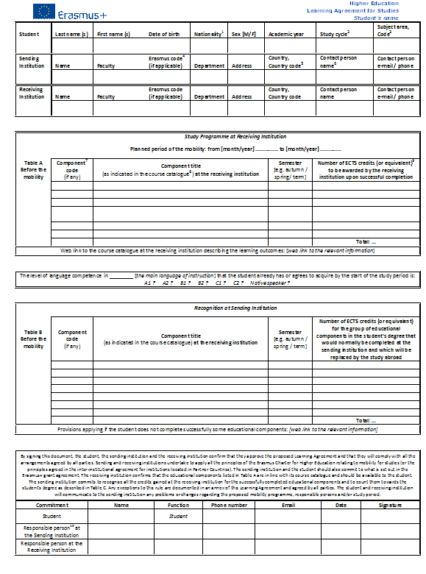
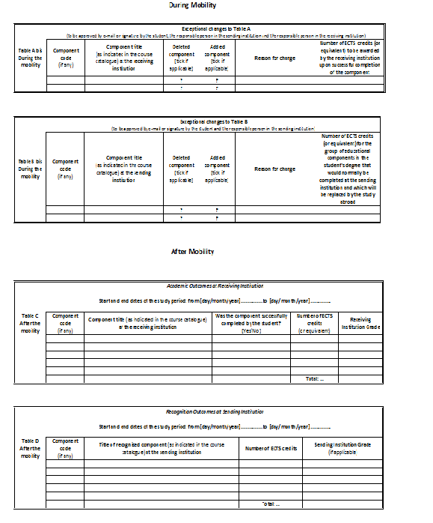

Slide 24
Online Learning Agreement
Instead of printing a PDF or a paper copy of a document a Learning Agreement, you will be able to approve the documents you need as an online.
Please ask your partner institution to digitally approve them.
You can fill out your LA form from our Erasmus application portal.
https://app.erasmus.bilkent.edu.tr*
* You will be contacted in mid-March regarding your portal access.

Slide 25
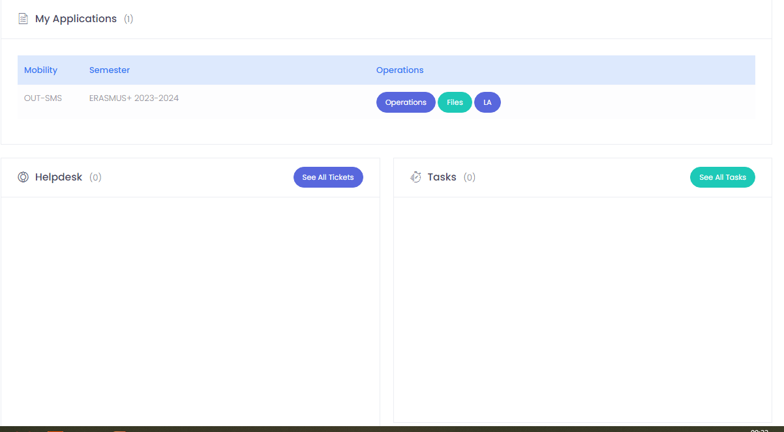
Online Learning Agreement

Slide 26
Learning Agreement
Your LA form needs to be signed by
The student,
Responsible Person at Sending Institution (dept. exchange coordinator at Bilkent)
Responsible Person at Receiving Institution (coordinator at the partner unv.)
After getting all the signatures, please submit your LA form to;
1.Your Erasmus Departmental Coordinator at Bilkent
For Faculty of Economics, Administrative and Social Sciences: Betül Esmer,
For Faculty of Business Administration : Buket Bıyıklı
For Faculty of Engineering: Yelda Ateş
For Faculty of Art, Design and Architecture: Melek Koca Er
For other departments: Your Departmental and Exchange Coordinators
2. Office of International Students and Exchange Programs (exchange-out@bilkent.edu.tr)
As mentioned, LA’s that are prepared and signed on PDF format will be accepted.

Slide 27
Learning Agreement
If you have previously take a course and failed it, we do not advise you to take
that course during your Erasmus period, because;
Even if you pass the course when you are back, you will be exempted from the said course, however the weigh of the F grade will not change and it will continue to effect your CGPA. Thus, we do not advice you to do that.
If you are enrolled in a Minor Program;
During your Exchange semester, you are limited to take 1 course only for Minor Program credits. This course must be approved by your Minor Program's department coordinator.
Please ensure that your Minor Program's department coordinator's name and signature is mentioned on your LA as well as Pre-approval forms.

Slide 28

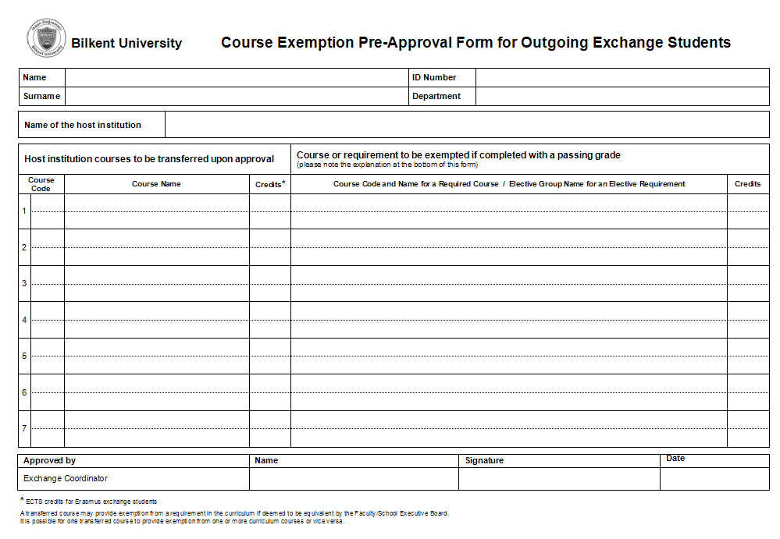
Pre –Approval Form
You can fill out with your Departmental Exchange Coordinator and get his/her signature.
Pre-Approval Form can reached from; https://www.bilkent.edu.tr/bilkent/admission/outgoing_exchange/selected_students.html

Slide 29
Pre –Approval Form
Please keep in mind that;
If you make any changes to your Learning Agreement update your pre-approval form and get the signatures of your departmental exchange coordinator while you are there and send a copy to us.
Pre-approval Forms that are prepared and signed on PDF format will also be accepted.
The minimum course load an Erasmus exchange student has to take per semester is 30 ECTS. In order to get your Erasmus grant, you have to fulfill this rule!

Slide 30
Pre –Approval Form
Then, submit it to your Erasmus Departmental Coordinator at Bilkent
For Faculty of Economics, Administrative and Social Sciences : Betül Esmer,
For Faculty of Business Administration : Buket Bıyıklı
For Faculty of Engineering : Yelda Ateş,
For Faculty of Art, Design and Architecture : Melek Koca Er
For other departments: Your Departmental Exchange Coordinators
And our office, OISEP
Please also keep one copy for yourself.

Slide 31
Acceptance Letter
Please check, the email address you have stated in your application regularly. All the necessary information and your Acceptance Letter will be sent to this email address or by post.
As soon as you receive your Acceptance Letter, submit a copy to our office or send it via email to
exchange-out@bilkent.edu.tr
It will not be possible to calculate the Erasmus grants of the students without an acceptance letter!

Slide 32
English Certification Letter
During your online application,
English Certification Letter
could be requested by your Host Universities
so please send your request to
hazirlik@bilkent.edu.tr

Slide 33

Extended Health and Travel Insurance
for Education
All students have to get an Extended Travel and Health Insurance, covering the dates of their stay, and submit a copy to our office before they leave.
Insurance contracts that have a 92 day limitations will not be accepted.
Even if you have to get another insurance at the host country, you still have to get a Travel and Health Insurance before you leave Türkiye.

Slide 34
Health Insurance by A/T 11 Document
Students who are planning to study in Germany must prove either a valid German Health Insurance or the original version of the Social Insurance Agreement between Türkiye and Germany (document A/T 11)
To get the corresponding document, students have to be insured by SGK or Emekli Sandığı/SSK/Bağ-Kur, otherwise it won´t be possible to get the A/T 11 document.
Students who have A/T 11 Health Insurance document must be subscribed to a travel/health insurance as well.
This is a mandatory rule for Erasmus grant payments since all Erasmus students must be subscribed to Travel and Health insurance before their departure!

Slide 35
Preparing for the Grant
Students who have been awarded the Erasmus grant have to submit their acceptance letter to OISEP and open a bank EURO (€) account at YapıKredi Bank.
They need to send the IBAN number of EURO (€) account and the branch name to exchange-out@bilkent.edu.tr
via email at least two months prior their departure.
Important reminder:
All students must share their Acceptance Letters for acquiring the below mentioned documents;
Their Erasmus Grant Letter that provides the Erasmus grant amounts for Visa purposes
Receiving their AT11 letter to be given to SGK
Unfortunately we cannot issue these documents without your acceptance letters!

Slide 36
Preparing for the Grant
Please send the IBAN number of your bank accounts as
“TR60 0006 7010 0000 0000 0000 00”
  ‘ ....... Bank Name with Branch’ via email.
  All students who are granted or not, have to open an account and send it to
  exchange-out@bilkent.edu.tr
  Please make sure that you send your EURO accounts only, not TRY ones since grant payments cannot be made to TRY accounts!
  Your EURO accounts must be in your name not in your family name.

Slide 37
Erasmus+ Participant’s Report
After the completion of the Erasmus documents, the European Commission will sent ‘Online Participant’s Report’ to your Bilkent e-mail using the ‘Beneficiary Module’.
All students, regardless of grant status, are required to complete and submit the Participant Report online.
You have to fill and submit it online
for being eligible to the remaining 20% grant payment.
Please submit your online report on time!

Slide 38
Remaining Grant
Your remaining 20% grant payment will be calculated based on your exact study period, as approved by the partner university and indicated in your official dates form.
Your resit exam periods are not included in the calculation of the remaining part of your grants.

Slide 39
Travel Support Grant
Students receiving the Erasmus+ grant will be eligible to have additional Travel Support grant for their semester abroad.
This is a round-trip amount paid once only to contribute to the travel expenses of Erasmus+ students and will be paid to all students after completing the need documents in the `Before Mobility` part of our Checklist.
The distance in kilometers between the starting point of mobility and the location of the activity should be determined using the distance calculator provided by the European Commission.

Slide 40
You can access the calculator at http://ec.europa.eu/programmes/erasmus-plus/tools/distance_en.htm.
Based on this distance, the travel grants are calculated paid to the students.
Calculation is not based on flight tickets.
Travel Support Grant
Travel Distance | Standard Travel Grant Amount (Euro) | Green Travel Grant Amount (Euro)
10 to 99 KM | 28 | 56
100 to 499 KM | 211 | 285
500 to 1999 KM | 309 | 417
2000 to 2999 KM | 395 | 535
3000 to 3999 KM | 580 | 785
4000 to 7999 KM | 1188 | 1188
8000 KM or more | 1735 | 1735

Slide 41
Student Visa
Students whom submit their acceptance letter to OISEP, can receive a letter stating that they are Erasmus students and if applicable, they will be receiving a monthly Erasmus grant.
  ATTENTION:
  You can find the most updated list of the documents you need to submit to the embassy, from their web pages.
  All students are responsible to learn about the visa procedures of the host country and complete the process on time.
  Some countries have their special visa rules.
The visa procedures in countries such as Germany, Poland, Hungary, Belgium, Slovenia, the Czech Republic take a long time thus, you need to apply as soon as possible and learn about the application process in detail.

Slide 42
ERASMUS GRANTS

Slide 43


Erasmus+ Student Mobility
Program Grants per Group
Country Groups | Host Countries | Grant per Month for Student Mobility(EURO)
1 and 2. Group Program Countries | Germany, Austria, Belgium, Czech Republic, Denmark, Estonia, Finland, France, Cyprus, Netherlands, Ireland, Spain, Sweden, Italy, Iceland, Latvia, Liechtenstein, Luxembourg, Malta, Norway, Portugal, Slovakia, Slovenia, Greece, United Kingdom | 600,-
3. Group Program Countries | Bulgaria, Croatia, North Macedonia, Lithuania, Hungary, Poland, Romania, Serbia | 450,-
Notes:
43

Slide 44
ERASMUS GRANTS
The method and time of payment
Erasmus grant allocations for all universities in Türkiye are announced in July or August every year and subsequently distributed to participating universities. After Bilkent University's total grant amount is determined, these funds are allocated to individual departments and students.
Since the grant amounts fluctuate annually, it is not possible to allocate specific grants to departments or issue individual grant letters to students before the nationwide grant announcements are made.
Until the official grant announcement, selected students for Fall Semester will be able to obtain an Erasmus+ Studentship Letter (without grant details) once they receive their acceptance letters. This letter can be used for visa application purposes. We strongly recommend that you review the embassy’s requirements for sponsorship or proof of funds and prepare your visa application accordingly.
If you foresee potential visa difficulties due to the absence of grant details in your initial letter, you may opt to defer your Erasmus program to the Spring semester of 2026, subject to approval from your Faculty Erasmus Coordinator. Please note that students graduating in Spring 2026 are not eligible for this deferral.

Slide 45
ERASMUS GRANTS
The method and time of payment
Erasmus grants awarded by the National Agency to Bilkent University for the support of Erasmus Students, covered around 55%-100% of each department’s selected students in the previous Academic Years.
2026-2027 Erasmus grant results will be announced in
July or August 2026.
The distribution of grants will be done from the highest ranking applicant to lowest one on the list within each department independently and will cover one semester only.
Selected students who cannot be funded, but are able to meet their expenses themselves are welcome to go on exchange.
Granted students who may withdraw from the program will be replaced by the next ranking student in each department.

Slide 46
ERASMUS GRANTS
The method and time of payment
Important Notice;
Erasmus grants should be considered as a financial support to the participants but they will not be sufficient to cover all the travel, accommodation and living expenses abroad.
Please consult this issue with your family as well, since granted students will still need to get additional financial support from their families depending on the cost of living in their Erasmus destination.
As mentioned earlier, selected students who cannot be funded with Erasmus Grants, but are able to meet their expenses themselves are welcome to go on exchange as an Erasmus+ zero grant student for semester dates only.

Slide 47
...time and method of payment
The payments are only made on Fridays by the Finance Department of the university.
Grants are paid in EURO.
The grants are calculated according to your acceptance letter.
80% will be paid before you leave if you submit all the requested documents at least 1 month prior your departure and the remaining 20% will be paid after your term abroad is completed and all the relevant documents are submitted to OISEP.
It is the students' responsibility to complete all needed documents for being eligible to get the grant payment.
Payment process cannot start without completing the documents and may take at least 1 month. All students must consider this and have to submit before mobility documents accordingly. Otherwise, they may not get the grant before their departure to the partner university!!!

Slide 48
SEMP Scholarships
The "Swiss-European Mobility Programme" (SEMP) continue in 2026-27. The Swiss Government should grant a SEMP scholarships to incoming exchange students who are nominated in the frame of the SEMP programme.
Due to overall governmental austerity measures, the Swiss Government cannot guarantee SEMP scholarships for incoming students for the application period of 2026–2027 academic year and will inform exchange students of their eligibility to the scholarship in the acceptance letters.
Majority of the students who are going to Switzerland have received SEMP scholarship since the beginning of programme.

Slide 49

Under which conditions the grants are not paid or reclaimed?
If you stay at the host university less then 2 months without an relevant excuse, you will have to reimburse the total amount and will not be accepted as an Erasmus student.
If you fail all your courses due to attendance or return with ‘0’ ECTS you will not be receiving the remaining 20%.
Furthermore, you have to pass minimum 2/3 of the total 30 ECTS to be able to receive the remaining 20%.

Slide 50
ERASMUS PROCESS
Before you go
While you are there
Upon your return

Slide 51
...While you are there
Departure
Be at the host university on the exact date stated on your acceptance letter. Do not miss the orientation program. Do not leave before the term is completed.
2. Learning Agreement
If you have to make any changes to your Learning Agreement, fill out the During Mobility part, complete the signatures and send it to us via email. Do not forget to update your pre-approval form accordingly and get it signed by your exchange coordinator at Bilkent and send it to us.

Slide 52
... While you are there
3. Official Dates Form
Before your departure from the host university, download the Official Dates form from our webpage and get it signed by the International Office of the host university in accordance with the entry and exit dates of your passport. (For all students, regardless of grant status)
Official Dates Form can be reached from;
https://www.bilkent.edu.tr/bilkent/admission/outgoing_exchange/selected_students.html
ATTENTION:
This document will be your proof of stay abroad and final Erasmus grants will be re-calculated according to this form.

Slide 53
... While you are there
Transcript
At the end of the term, if possible, bring your transcript, unopened or let the partner university staff to send it to exchange-out@bilkent.edu.tr
If this is not possible, make the necessary arrangements for letting them to send it to our office.
Postal Address:
Bilkent Üniversitesi, Merkez Kampüs, Uluslararası Öğrenciler ve Değişim Programları Ofisi, 06800, Bilkent, Ankara, Türkiye

Slide 54
ERASMUS PROCESS
Before you go
While you are there
Upon your return

Slide 55
Upon Your Return
The documents you have to submit to OISEP are as follows;
Learning Agreement: Online or dully signed PDF. Make sure all the signatures are completed.
Official Dates Form: Signed by the host University that covers the period of stay must be sent to exchange-out@bilkent.edu.tr by host university staff.
Passport Photocopies/Scanned pdf: Including the information page and the exit and entrance stamps
Transcript: If the transcript sent to you by the host university, make sure you deliver it to our office unopened. Your transcripts can be sent to OISEP directly.
Participant’s Report: After the completion of the above mentioned documents the European Commission will sent an ‘Online Participant’s Report’ to your Bilkent email using the ‘Beneficiary Module’. You have to fill and submit it online for being eligible to the remaining 20% grant payment. (For all students, regardless of grant status)

Slide 56
Important Notes
Minor Studies:
  Exchange Students can only transfer one course that they have taken during their exchange term, to their minor program.
  They have to get the approval of the department exchange coordinator of their minor program before they leave for the program and show it both on their LA and pre-approval form.
Dormitories:
  Those students staying at the dormitories should inform the Dorm Management that they will participate to the program. This should be done before the deadline the dormitories have announced.

Slide 57
Important Notes
  Students that hold Scholarships
    Scholarship students that participate to the program have to pass, at least 4 courses for their scholarship to continue.
    For more information, send e-mail to burs@bilkent.edu.tr
  Students paying fees to Bilkent University
    Students participating in the exchange program will continue to pay their regular tuition fees to Bilkent University for the duration of their exchange period.

Slide 58
Important Notes
Merit Scholarship
  If an exchange student is also a candidate for Merit Scholarship, the CGPA of the last term that they have spent at Bilkent will be taken in to consideration for evaluation.
  When they spent one academic semester as an exchange student, they will be considered for Merit Scholarship.
  Please also be informed that a student with a CGPA below 3.00/4.00 will not be considered for Merit Scholarship.
  Furthermore the students have to pass at least 5 courses during their exchange period.
For details and more information, you can send e-mail to burs@bilkent.edu.tr

Slide 59
Important Notes
Grades:
  No matter what grade you receive during your exchange period, all grades taken abroad will be shown on your Bilkent transcript.
  You cannot upgrade your grades during your exchange period. Even if you receive a higher grade for the courses you have received a ‘C’ or below at Bilkent, it will not change your grade at Bilkent University. You will be exempted from the course but, the grade you have received at Bilkent will continue to effect your GPA/CGPA.
  As a rule, if you receive a grade below C at Bilkent you can take the course in the next two semesters to increase it. Your exchange term will be counted towards one of these semesters.

Slide 60
For a student to be exempted from a must course in Bilkent, the course that has been taken during their exchange period, should be close to the must course in Bilkent according to its subject, scope, level and time period.
For a student to be exempted from an elective course in Bilkent, the course they have taken during their exchange period should be similar to the elective course group in Bilkent, according to its subject, scope, level and period. It is possible for one course to enable the exemption of more then one course at Bilkent, while two or three courses can enable exemption for only one course at Bilkent. For exemption the scope and the level of the courses are compared not the credit values.
If the passing grade and the grade to graduate is different at the host university, you need to get the grade to graduate in order for the course to be transferred.
YOU CANNOT TAKE PART IN THE EXCHANGE PROGRAM IN YOUR GRADUATION TERM!

Slide 61
Advices from OISEP
Take a record of our contact information.
Print the check list on our web page.
Check your Bilkent e-mail account on a regular basis.
Make sure to learn who your coordinator at the host university.
Submit the documents you are responsible for, on time.
PLEASE DO NOT LEAVE ANYTHING TO THE LAST MINUTE!

Slide 62
... Advices from OISEP
Read the History of the country you are visiting.
Prepare yourself for the questions that you might receive about Türkiye/your home country. Make sure you have the relevant knowledge about the topic. Do not take anything personal.
Follow the written rules of the country you are visiting.
Carry the photocopies of the official documents; passport, residence permit etc.
You can find this presentation and the necessary documents at our webpage (Outgoing Student’s Oritentation - please click here)
https://w3.bilkent.edu.tr/bilkent/outgoing-students/outgoing-students-oritentation/

Slide 63
Important Reminder for e-mails and phone calls
We kindly request you to write:
Your name,
Surname,
Department
ID number at the end of all your e-mails and also provide it to us during your phone calls!
Also, use @bilkent.edu.tr mail accounts only, for all your correspondence with us and partner universities.

Slide 64
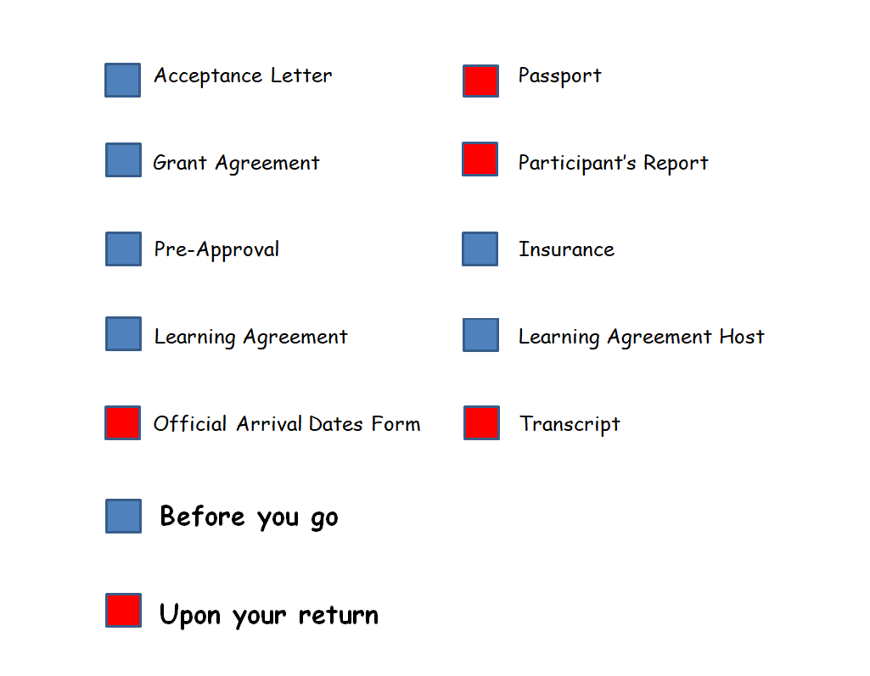
CHECKLIST

Slide 65

WE HOPE YOU HAVE A GREAT EXCHANGE EXPERIENCE!!!!!

