Slide 1
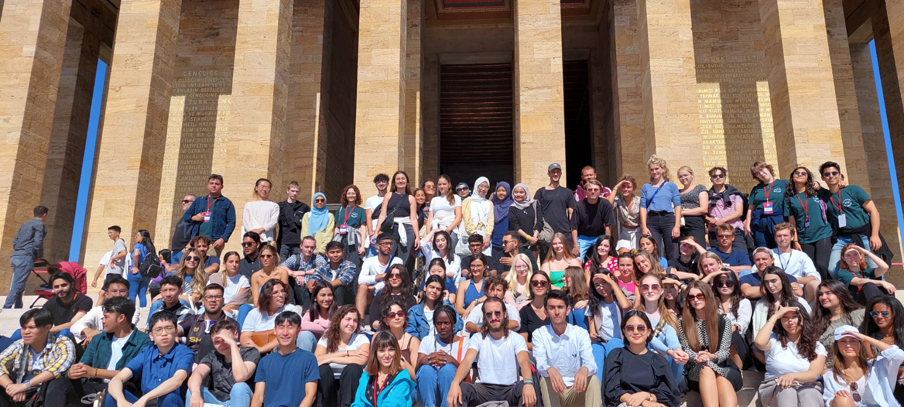



Slide 2

A- Administrative support for Incoming students:
  OISEP:
    Mr. Erkin Tarhan - Exchange Programs Director
    Mrs. Buket Hatam– Incoming Student Advisor
    Mr. Bilal Erbaş- Incoming Student Advisor
    Ms. Elif Ünsal– Outgoing Student Advisor
    Ms. Beyza Makam-Outgoing Student Advisor
    Ms. Layra Mete- Makam-Outgoing Student Advisor
    ESN Bilkent Club Members
B- Academic support for Incoming students:
Your Departmental Exchange Coordinators at Bilkent and Home Universities
but OISEP can act as mediator if needed
Notes:
Hello everyone! Welcome to Bilkent University. We are so happy to see you here!
I want to introduce myself and my colleagues. I am Buket Hatam . I am the responsible person of Incoming Students. Elif Unsal is responsible for outgoing students, my director is Erkin Tarhan and our new member is Beyza. We are all coming from OISEP.
Also, we have huge support from the ESN group. They are all full-time students of Bilkent University. They help you for adaptation the campus life. Please be kind to them. Because they help you volunteer. I want to thank them a thousand times for their help.

Slide 3

Course Registrations
Time: Please check the Academic Calendar from:
https://w3.bilkent.edu.tr/bilkent/academic-calendar/
Notes:
Our course registrations will be 24 January 2024 at 13.15 You need to apply with your departmental coordinator. ESN group will help you for your course registrartions.

Slide 4
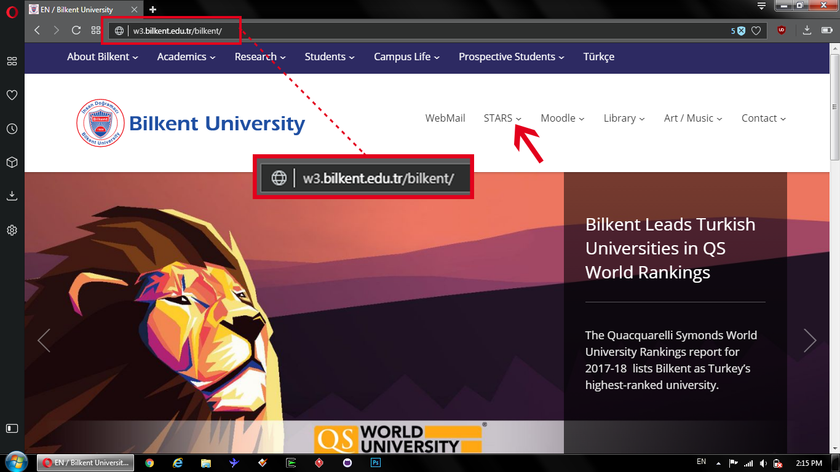
Course Registrations
Notes:
We just want show you the course registrtion process. After the course selection departmental administrative coordinators will do your registration, I want to show how can do course selection. First of all, you need to enter Bilkent University’s web page. Then select STARS menu- All-stars Services. Choose academic units.

Slide 5
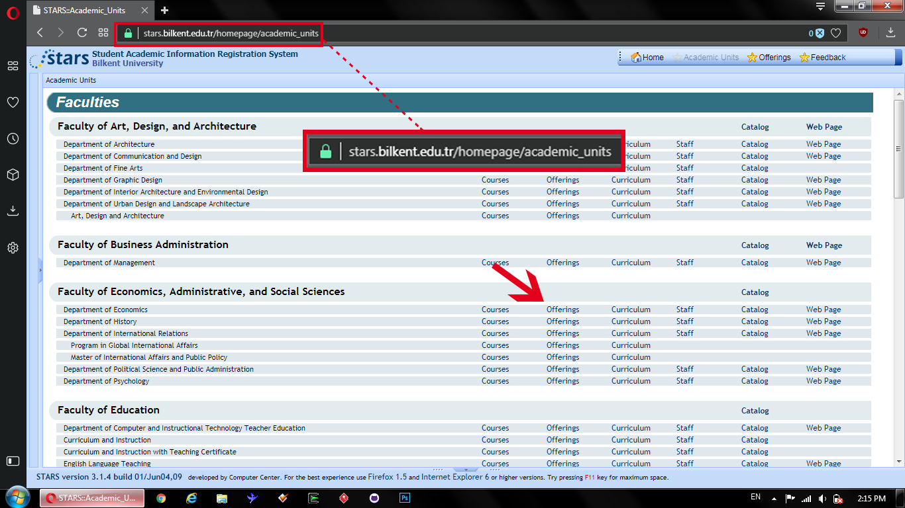
Notes:
You can see this page. All course offerings are here. Find your department and select the Course offerings section.

Slide 6
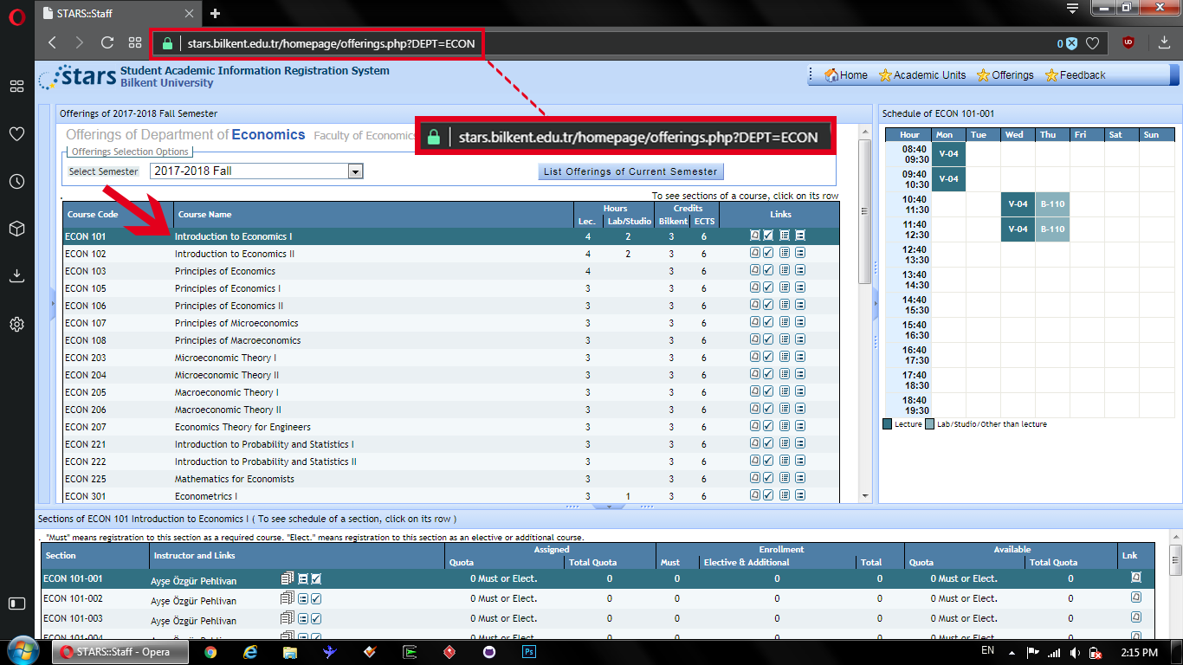

Notes:
Then you can see this page.

Slide 7
Course Offerings
ECON101 01 – Introduction to Economics I
Dept. Code Course Name Course Code Section Code
ECON Intro to ECON 1 101 01
ECON 101
201
301
401
501
601
Notes:
This is an example.

Slide 8

Important Reminder
According to Erasmus+/Exchange Program Regulations,
Incoming Exchange students must be registered to:
MINIMUM 4 to 6 courses
Depending on registered depts. regular course loads
or
30 ECTS in total for the Erasmus+ grant
Any modifications at course selection mentioned in
the course lists/learning agreements have to be
approved by home university first!
Notes:
It depends according to the practice of your home university.

Slide 9
Important Reminder
Erasmus+/Exchange Program Students’ course registrations can be made by Department Coordinators/Secrataries ONLY!
You must personally go to the department and ensure that your
Registration is done. E-mail communication is recommended.
You can make modifications at your registered course list
during add/drop week.
Notes:
It depends according to the practice of your home university.

Slide 10
Important Reminder
Course Codes start with «4» can be 4th year final projects for resident
students, so please consider this to avoid problems!
Resident Student Course Registrations will be opened a day after the exchange students.
Please keep in mind that you can find emtpy slots on exchange Student Registration day ONLY!
Last Day for Adding/Dropping Courses for all students:
https://w3.bilkent.edu.tr/bilkent/academic-calendar/
13:00-Course Drop Deadline
16:00- Course Add Deadline
So please finalize your course lists with your universities!
Notes:
So, all your academical questions please contact with your departmental coordinators.

Slide 11


Reminder for Courses
* Attendance is obligatory for all courses at Bilkent University. Course Syllabuses must be checked for details.
* Students who have not met the minimum performance and/or attendance requirements to qualify for the final exam receive an FZ grade before the final exams begin. Failing students who have not shown up for the final exam receive an FX grade instead of an F.
* In undergraduate programs, A grade of C or higher (or S for non-credit courses) is a passing grade for the course. Letter grades F, FX, FZ, and U are all failing. Grades C-, D+ and D are considered failing grades when the student's Cumulative Grade Point Average (CGPA) is less than 2.00 and conditionally passing grades when the CGPA is 2.00 or higher.
* In graduate programs, in addition to grade S, a grade of C or higher is a passing grade in master's programs, and a grade of B or higher is a passing grade in Ph.D. Programs. Letter grades lower than C and grade U are failing grades in master’s programs, and grades lower than B and grade U are failing grades in Ph.D. programs.
* No remote exams for all students!
* Make-up exam decisions can be made by the academic departments through a valid Health Report taken from Bilkent University Health Center only.

Slide 12

Important Reminder
Example for 2025 - 2026 ACADEMIC CALENDAR
Fall SEMESTER
Official Arrival Dates: 6-7 September 2025
Orientation8-14 September 2025
Course Registrations: 10 September 2025
Course Registration for Department Students: 12 September 2025
Residence Permit Application: 11-12 September 2025
Classes Begin: 15 September 2025
Course drop deadline for exchange students (13:00) : 19 Sptember 2025
Course add deadline for exchange students (16:00) : 19 September 2025
* This can only be done with course coordinators and department secretaries.
Withdraw Deadline: 22 October -5 November 2025 (17:30)- Graduate Students cannot withdraw from courses.
Last Day of Classes: 24 December 2025
Final Examinations: 25 December 2025- 6 January 2026
Grades Announced: 10 January 2026
Notes:
Here are the important dates for the fall semester. I wanna give an important reminder:
Graduate Students can’t withdraw from courses.

Slide 13
Important Reminder
Holidays:
Example for 2024-2025 Spring Semester
27 October, Holiday
28 October, Holiday
29 October, Repulic Day Holiday
1 January, New Years Holiday
Early finals are not always recommended but they can be made upon the course
instructor’s decision
Please consult this matter at the beginning of the semester only!
Notes:
Here are the holidays . Also I want to give another important info. Your right to not attend a class is 10%.

Slide 14
Important Reminder
Going out for a drink;
During the Orientation Program period, this should be neglected due to bad previous experiences like missing Orientation tasks or Turkish Classes
ESN Bilkent will be organizing social events every week
after the end of the orientation program
Notes:
Due to the negative events, we experienced during the orientation; We do not recommend going out for drinking until late at night. Please obey the rules.

Slide 15
Residence Permit
Please check Orientation Program or your semester
Example for 2025-2026 Spring;
Online application , 11 and 12 September 2025
Participation is MANDATORY!
You need to bring:
Passport
Insurance Contract*
4 Passport size photos**
850TL (might change)
**There is a photo studio at ANKUVA for those who do not have them
Notes:
For residence permit application you need to bring,passport,health insurance,4 biometric photos. Also residence permit application fee is 850 TL.
Since the residence permit application fee is not charged for a short period in the online payment option and this amount is requested as 1200TL. Because of this, you have to go to the immigration office to pay the 850TL fee. If you don’t want to go to the immigration office, you can give 600TL to our ESN group, and they can go to the immigration office for a lump sum payment. Please prepare your redidence permit fee (600TL) in cash on 22 and 24January .
Insurandce must be in English and must have min 6 months coverage.

Slide 16

Security
Bilkent is a closed safe campus by all means.
Patrolling: Bilkent University security staff provides 24 – hour safety by making
regular rounds around the buildings, facilities and the green areas located in vicinity
of campus. On foot, bicycles and in cars, our security staff patrols the campus
and responds to alarm calls.
Emergency Call Center: Bilkent University Campus Emergency Call Center
Works 24/7.
In case of emergency, please call our campus emergency phone line at:
0312 290 66 66 or ext: 6666

Slide 17
Security
Feel free to email us at: exchange@bilkent.edu.tr
OR
Call us through Exchange Students Emergency Lines:
ESN Bilkent & International Office
ESN Bilkent will share their numbers
Campus emergency – 290 6666
OISEP :+90 312 290 3073-3197
Office Emergency Line for Orientation Week only
+90 501 517 19 23

Slide 18
Disciplinary Action Required Acts
All members of the Bilkent University have a right to feel welcome,
safe and supported. Certain attempts ‘on and off’ campus are considered an unacceptable behavior and may be required
a disciplinary and «in some cases» legal action.
Such as:
Inappropriate behavior from a student, staff or faculty member
Verbal or online threats, bullying Neglect or abuse of a minor
Sexual assault, sexual harassment, stalking or
relationship violence,
Use and Trade of all types of drugs
on and off campus
Use of alcohol on campus
Theiving
Notes:
We hope you won’t face these problems. But if you face one of them please contact us asap.

Slide 19
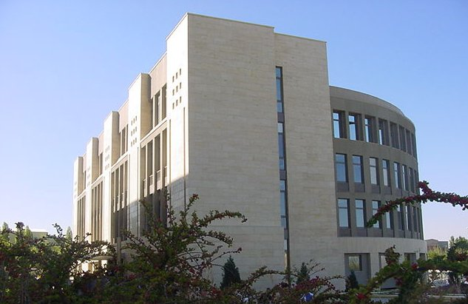


Bilkent
Computer
Center
BCC
Notes:
You are gonna do your resiidence permit applications in this building. Also you can use computer labs in here.

Slide 20
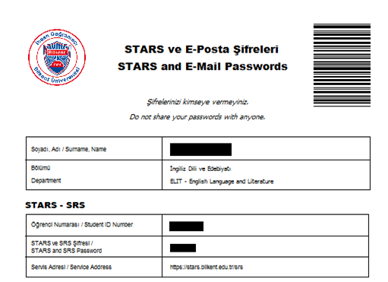
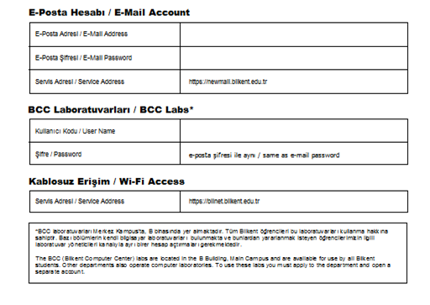
Your User Accounts and Passwords
Notes:
Here is the document about your user accounts and password. We gave this document to you when you came to the campus.

Slide 21
Student Email Accounts
You may check your email from:
https://newmail.bilkent.edu.tr/src/login.php
john@ug.bilkent.edu.tr (undergraduates)
john@bilkent.edu.tr (graduates and staff)

Slide 22
BCC Lab Accounts
Username: Bilkent webmail ID + “–ug”
Password: Email password
eg:
john@ug.bilkent.edu.tr
username: john-ug
password: ***********
Notes:
How can use BCC lab acounts?

Slide 23
Print Quota
You have an existing quota of 100 pages free
An extra 100 pages is 30TL
You may check your quota and buy more
from your Stars account
Notes:
Also you can request your enrollment certifictae ( Student Certificate ) from SRS account. You may lost your ID card. You can request your ID card from Stars account.

Slide 24
Dorm-Net Rules
Dorm-net is strictly for academic purposes
P2P or BitTorrent are not allowed
VoIP is OK
Infected/compromised computers are
blocked for a week; two weeks on
2nd incident; indefinitely on 3rd

Slide 25
VPN – Virtual Private Networking
To access services limited to Bilkent networks from
non-Bilkent networks.
VPN accounts are opened using the on-line services:
vpn.ug.bilkent.edu.tr
vpn.bcc.bilkent.edu.tr

Slide 26
BCC Lab Rules
Software installation by users is forbidden
Games (including chess) are not allowed
Quotas are imposed on printing
Students may not plug in their computers
to the lab network

Slide 27
Contacts for BCC
If you face any difficulties in VPN, Labs, E-mail accounts etc, please contact with BCC at;
hotline@bilkent.edu.tr
bilnet@bilkent.edu.tr

Slide 28
Turkey.home
Turquoise Timelapse: A week in Turkey
Turkey.Home - Turkey's Black Sea Mountains - From the Air
Please visit http://www.goturkeytourism.com/ for more videos
Notes:
Let's take a tour of Turkey.

